Slide 1

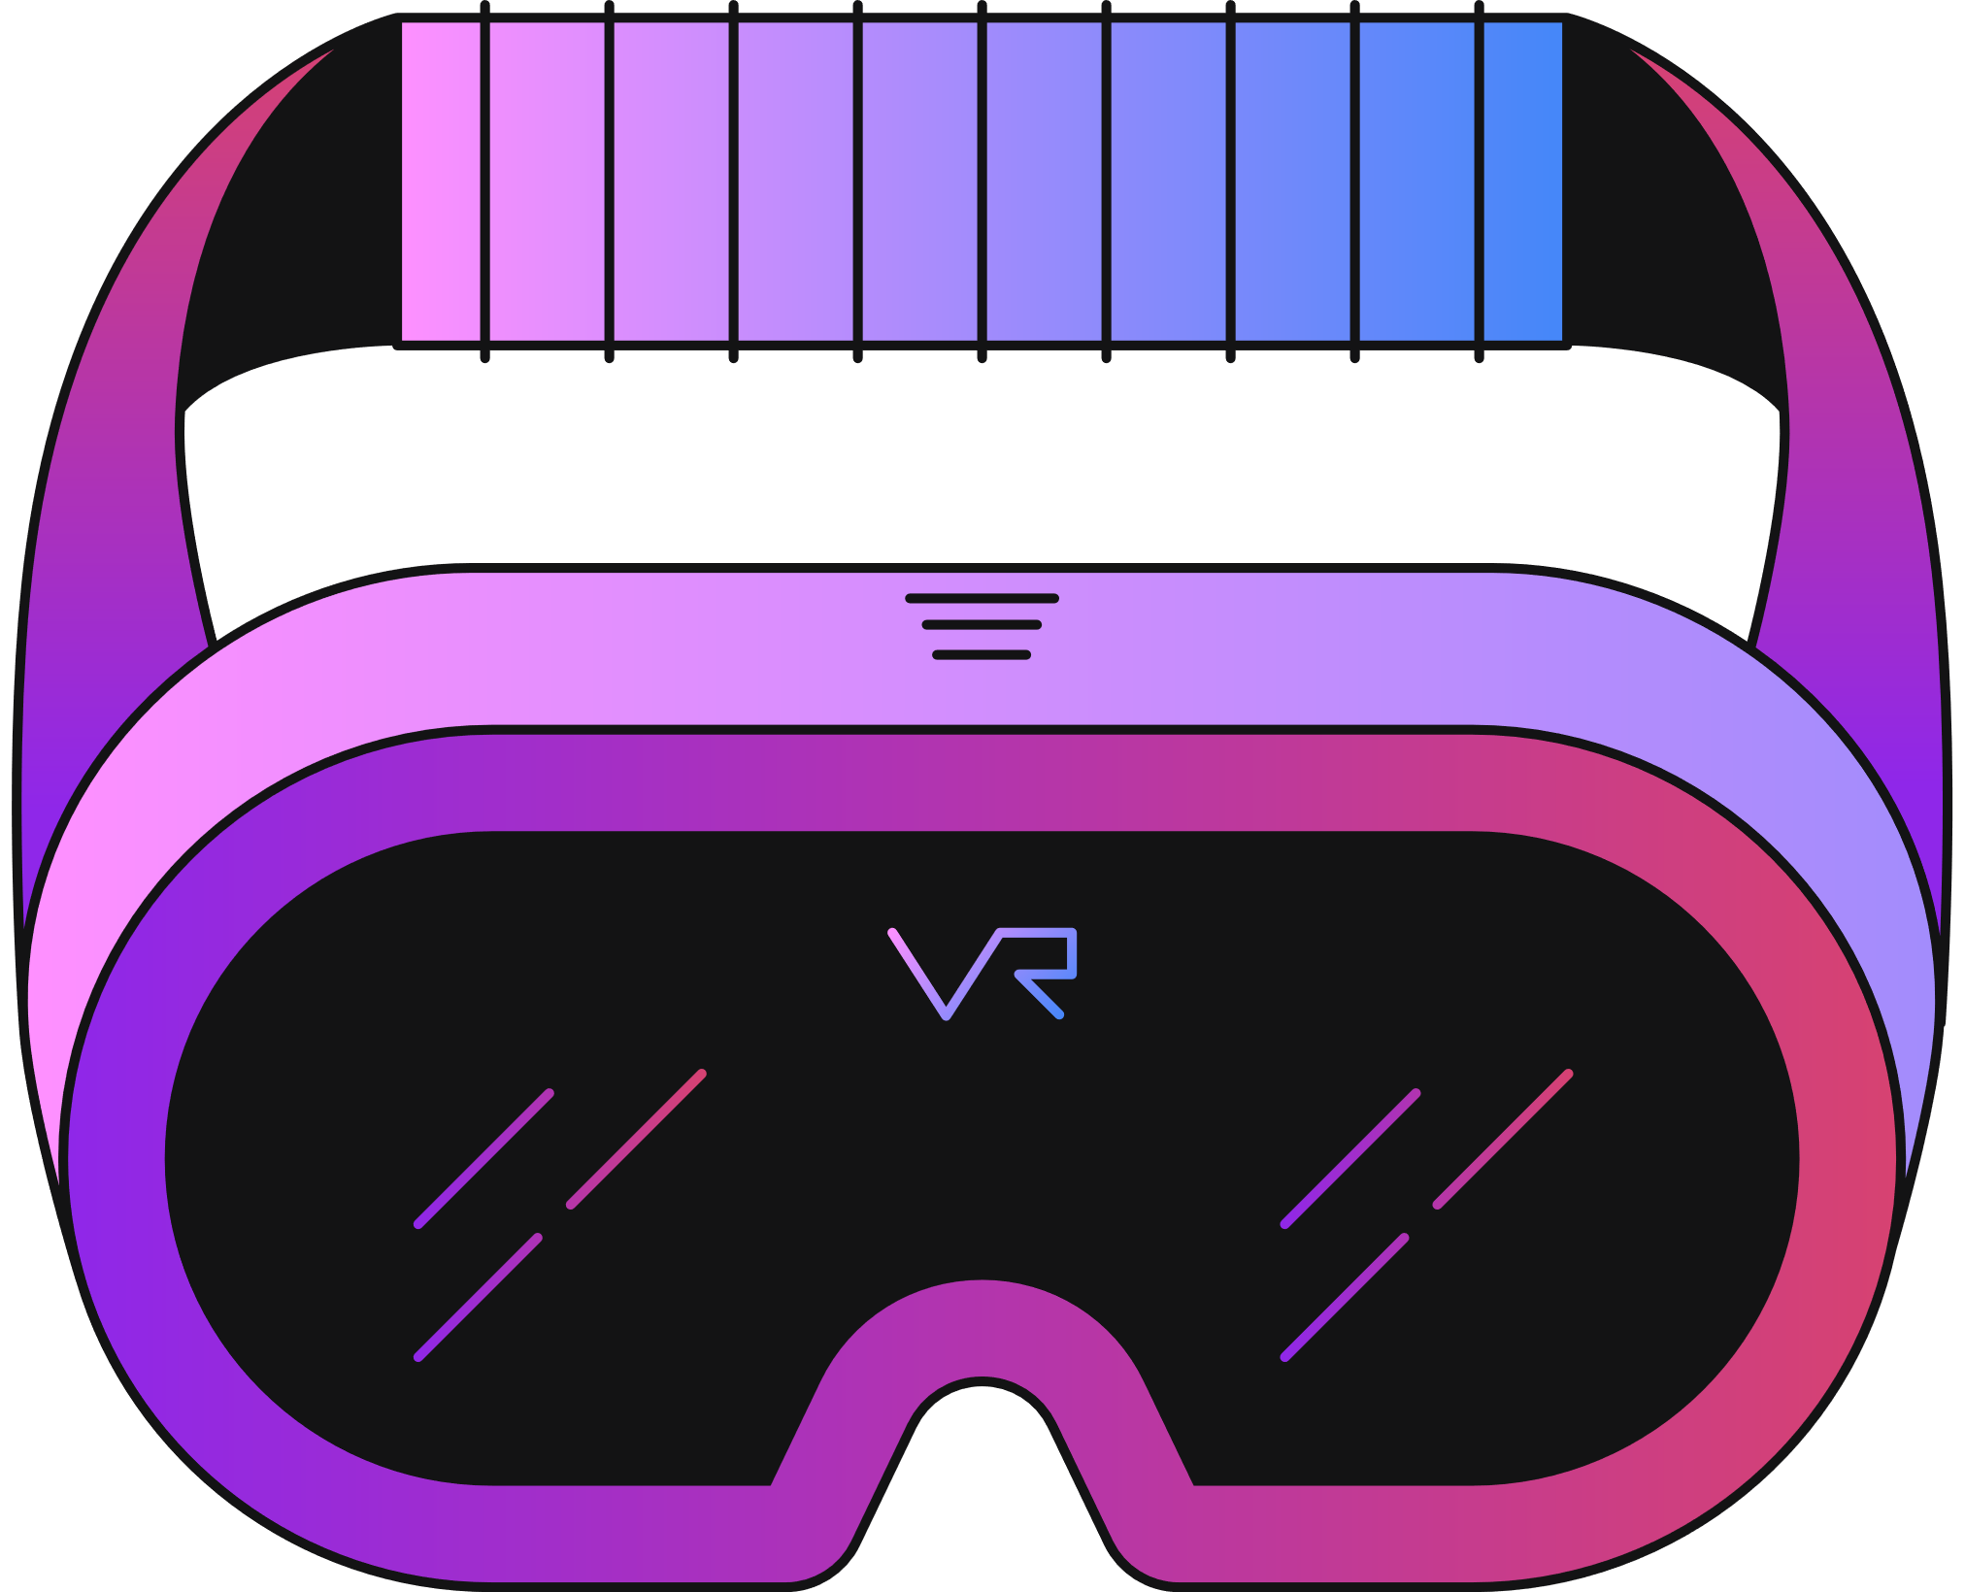
The Impact of Virtual Reality on Modern Education
Class: LCE - 115.3
Lecturer: Dimitrios Boglou
Stelios Farmakas – 30833
Nikolas Kokkinos - 30623
George Karyos - 30738
Revekka Kontou - 33350
Demetris Chambi – 30727
Survey – BaseD Insights
Notes:
https://tinyurl.com/2ht5p9xv

Slide 2

Introduction
To analyze the impact of virtual reality on modern education we created a Microsoft Forms questionnaire asking 66 people from different backgrounds about their experience.
The questionnaire aimed to get information on the following subject to get a general opinion on whether VR can be utilized on the educational field based on people's experience.
To conclude the study the responses will be analyzed .

Slide 3
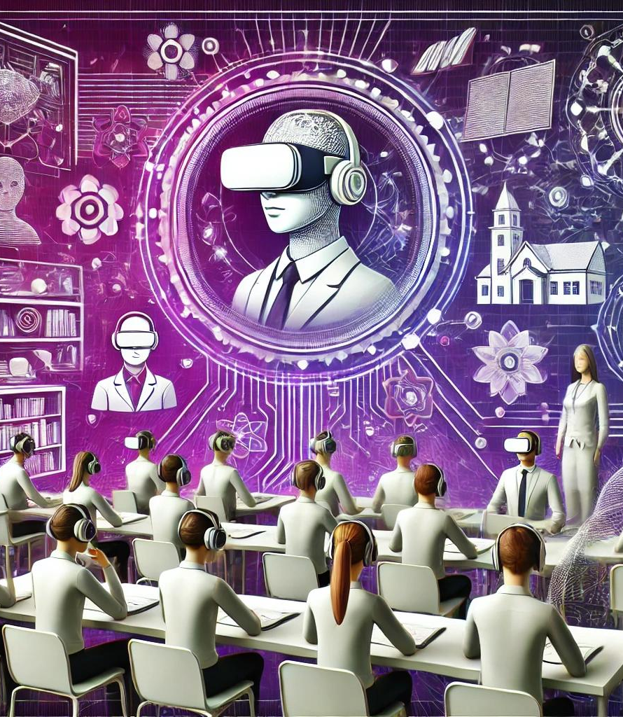
Our Questions
What is your age?
What is your gender?
What is your educational background?
What is your employment/occupation?
Have you used Virtual Reality before, and do you think it would be a useful tool to use in education?
If yes, how often do you use Virtual Reality?
Did you experience any problems during or after your VR session? (You can choose multiple answers)
In what ways do you think Virtual Reality could benefit education?
What concerns do you have about using Virtual Reality in educational settings?
On a scale of 1 to 10, how likely are you to recommend Virtual Reality as a tool for education?
If Virtual Reality was implemented in your educational setting, which of the following features would you find most beneficial?

Slide 4
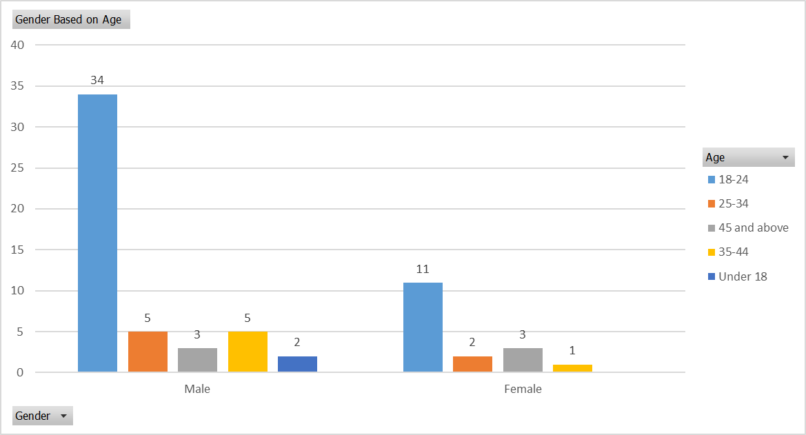

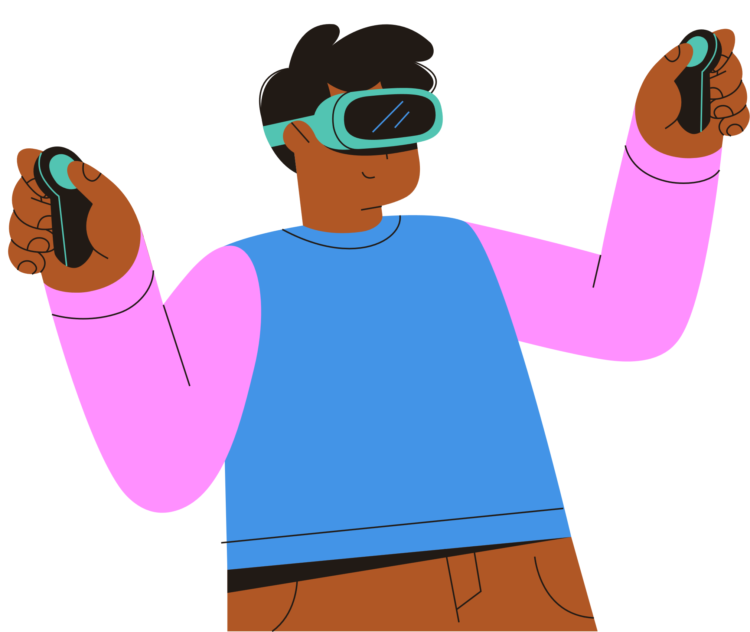
Gender-Age Ratio
Most of the answers came from individuals in the 18-24 age group, which constitutes the majority of respondents.
The total number of responses from males is 49, compared to 17 from females.
This indicates a significant interest in VR among younger age groups, with males being more dominant participants.
A

Slide 5
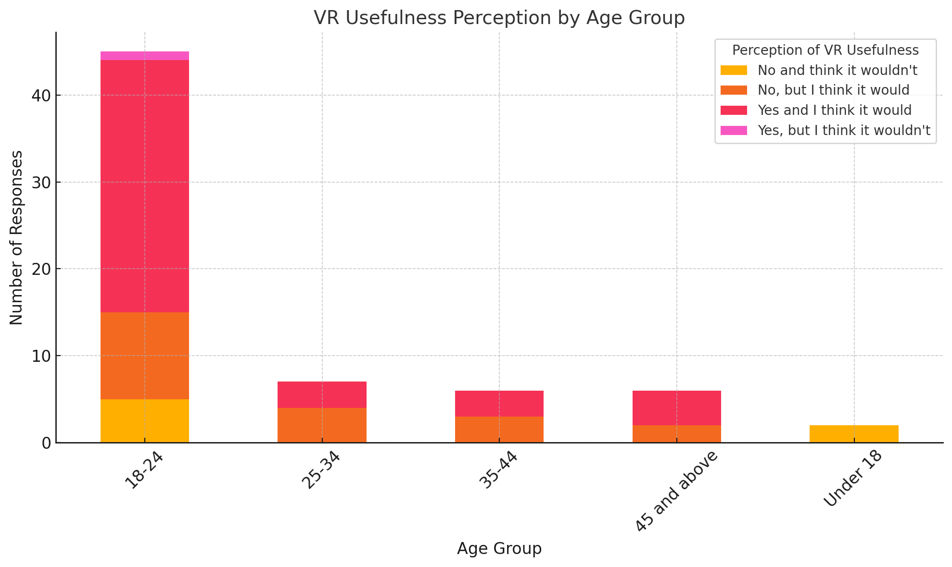
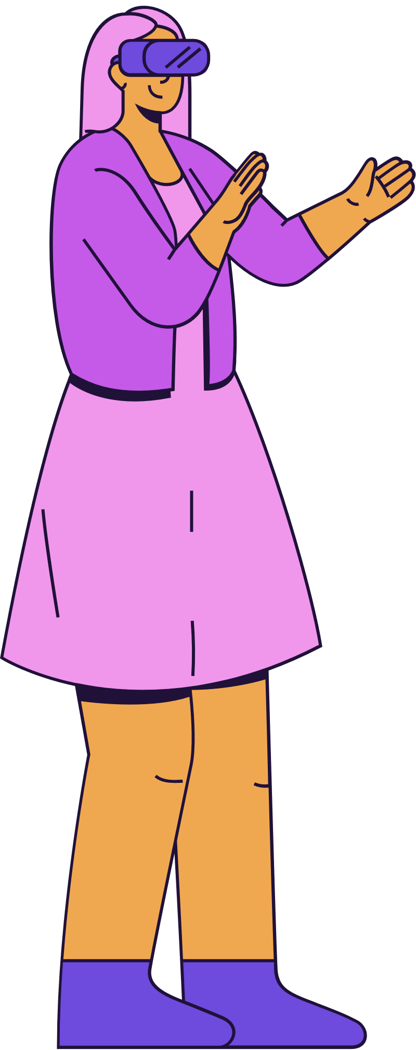
VR Usefulness Perception by Age Group
The 18-24 age group has the highest optimism, with the majority believing VR is useful for education.
Older age groups (35+ years) show reduced enthusiasm, with a few expressing doubts about its utility.
Under-18 respondents are relatively negative about VR's usefulness.
LET’S GET STARTED

Slide 6
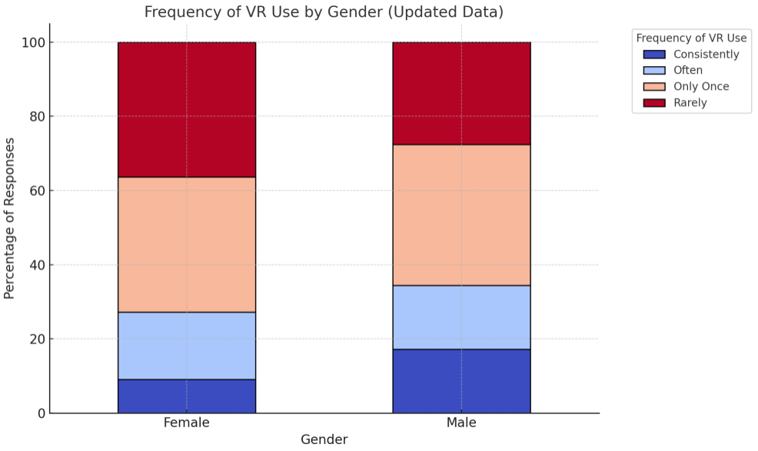
Frequency of use based on Gender
Based on the chart we can clearly see that that frequencies vary on both men and woman.
The biggest percentage of men and women have only used vr once or rarely showing that vr is not a part of their daily life.
A few said that they use vr often and even fewer said that they use it consistently.
A presentation is a formal or informal communication method that involves conveying information, ideas, or a message to an audience. It often employs visual aids such as slides, charts, graphs, or multimedia elements to support and enhance the spoken content.

Slide 7
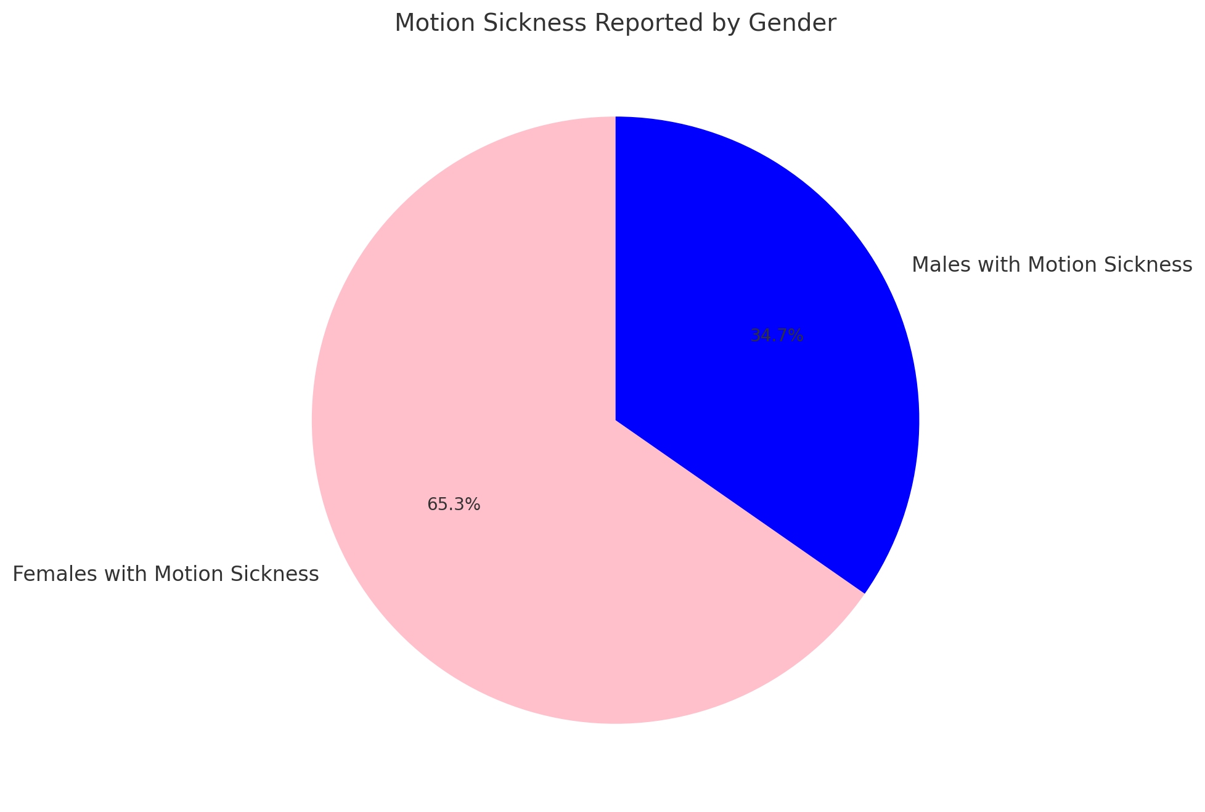

Motion Sickness Based On Gender
More females that used VR reported experiencing motion sickness, even though the number of males who submitted the quiz was much higher.
Specifically, 65.3% of females experienced motion sickness compared to 34.7% of males.
This highlights a potential gender-specific challenge in VR experiences, emphasizing the need for ergonomic or design adjustments to accommodate diverse user groups.

Slide 8
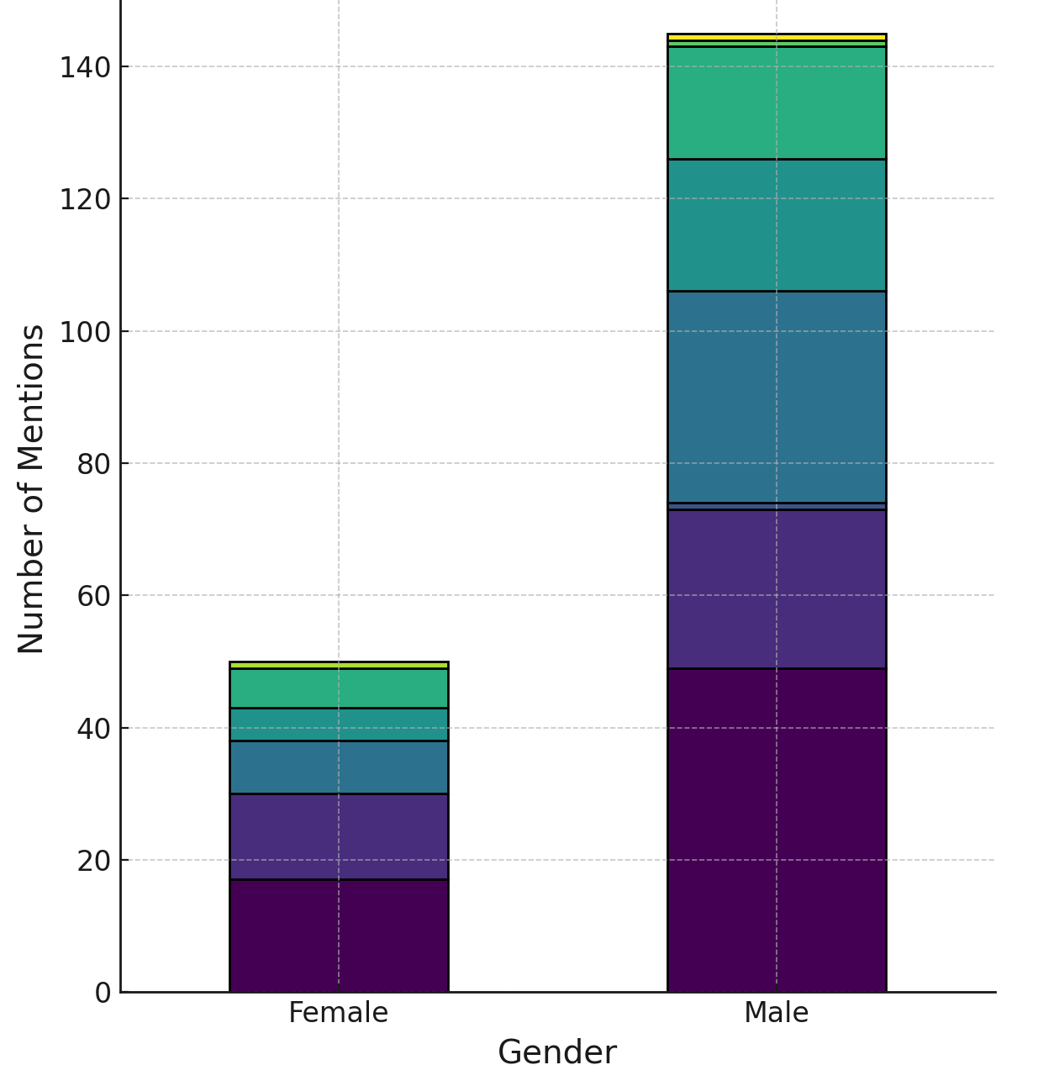
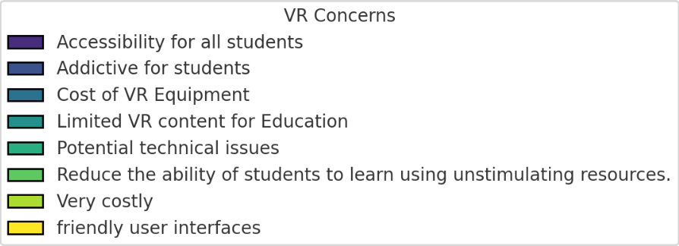
Top Concerns by Gender
Females: Tend to prioritize concerns around accessibility and usability, such as the complexity of VR hardware and ensuring it accommodates diverse student needs and learning environments.
Males: Focus more on the cost of VR equipment and technical challenges, including performance issues like lagging systems and reliability under educational demands.
A presentation is a formal or informal communication method that involves conveying information, , or a message to an audience.

Slide 9
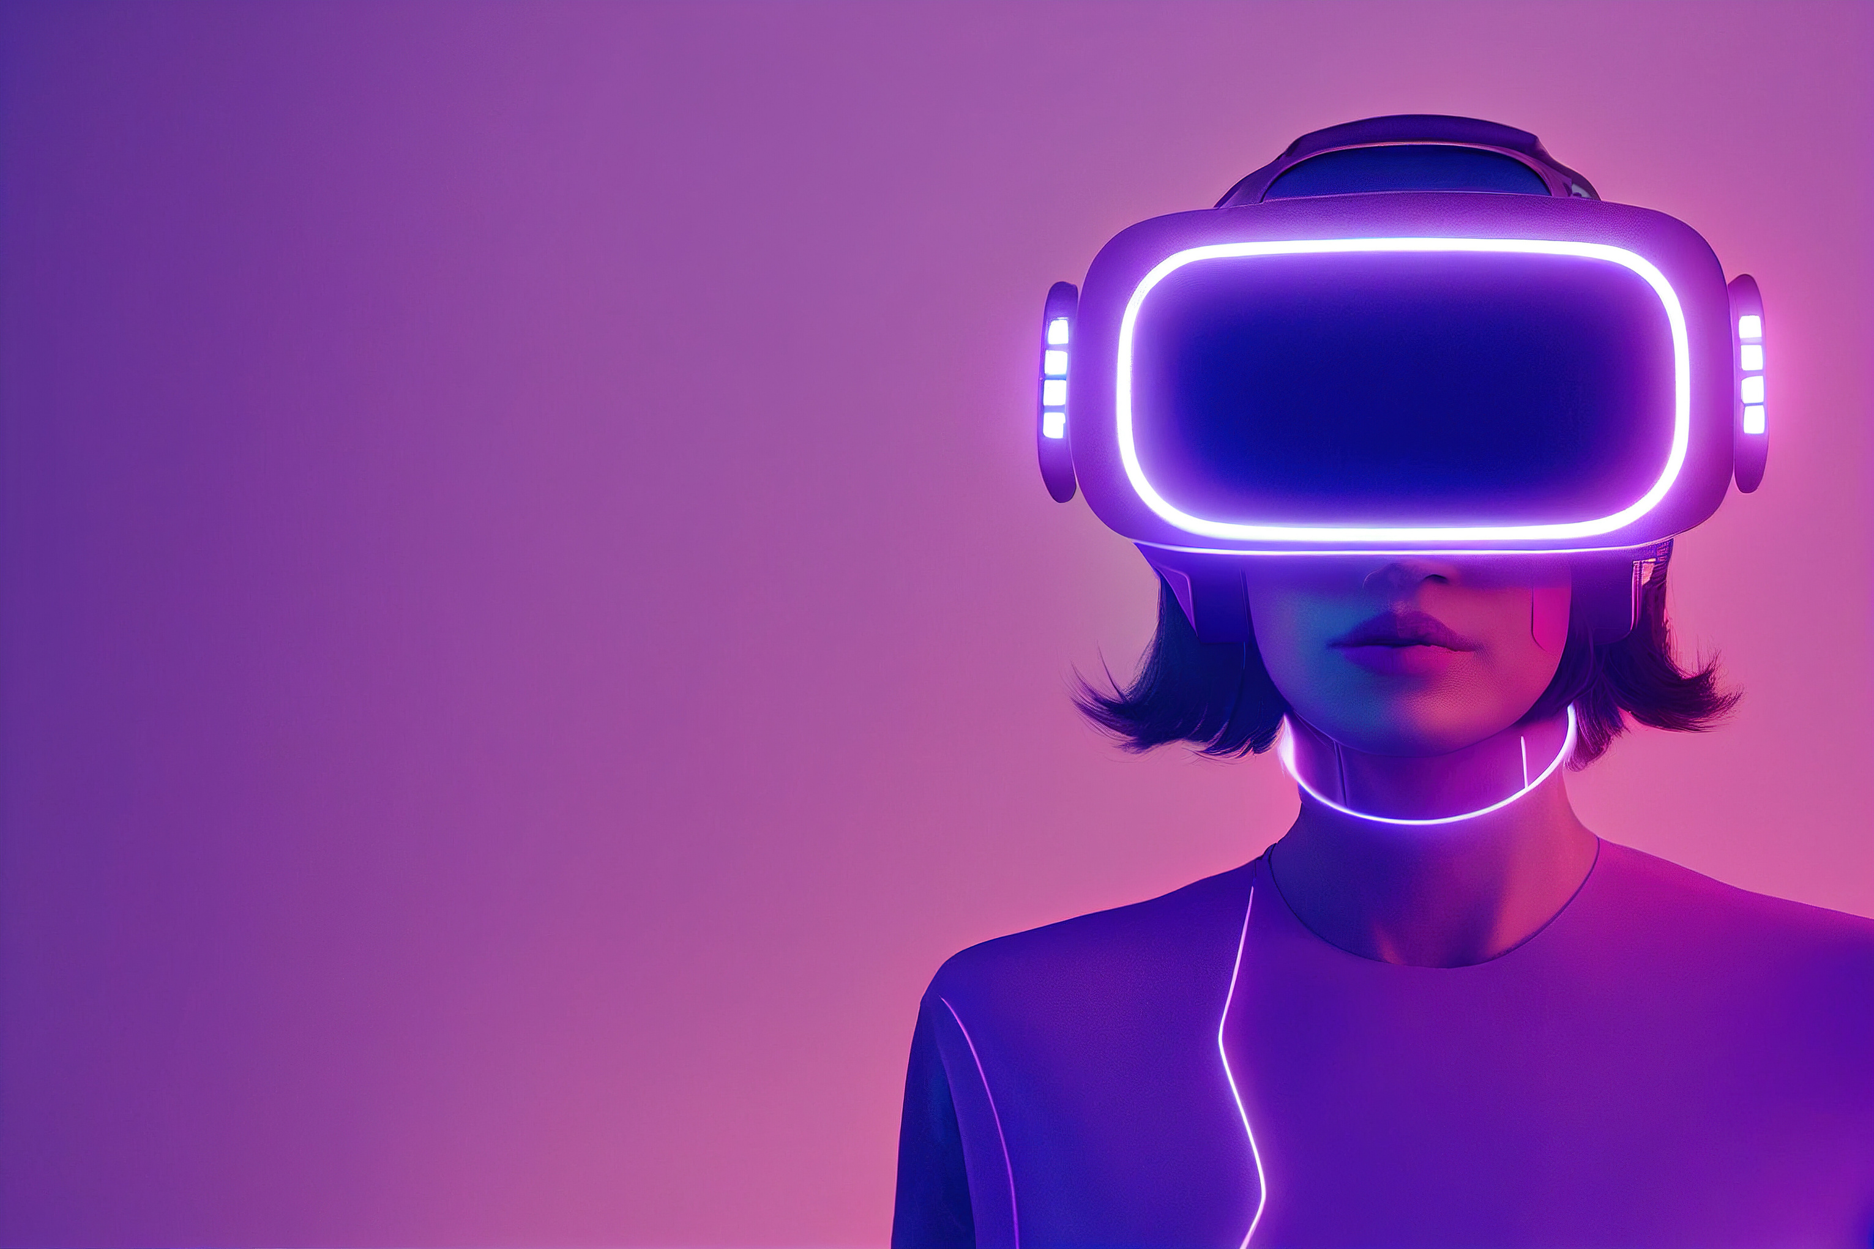
Possible Reasons Behind Gender Differences
Accessibility Concerns (Females):
  Limited access to high-tech tools or VR-integrated educational settings may amplify concerns about availability and inclusivity.
  A stronger preference for user-friendly designs ensures ease of use and adaptability for diverse learning environments.
  Cost Concerns (Males):
  Greater familiarity with technology might shift focus toward affordability and the long-term value of VR equipment.
  A perceived or actual role in budgetary decisions could drive an emphasis on cost-effectiveness and investment feasibility.

Slide 10
Thank you!

